Slide 1
IT investment analysis
[ Final ]
14146323 Seokhyen Chung
16102291 Anjoon Jung
14146322 Dongwon Jeon
14146325 Hongbeom Choi

Slide 2
Contents
Environment
Item Description
Perspective in Analysis
Technologies adopted
Current status & Future Prospective
Customer Analysis
Competitors Analysis
Market Analysis
Regulation
2. Benefit &Cost
Introduction Phase
Criteria
Benefit Analysis
Cost Analysis
Cash Flow
3. AHP Analysis
AHP Decision Hierarchy
Computing Priority
Consistency Ratio
Selection Alternative
4. Conclusion

Slide 3
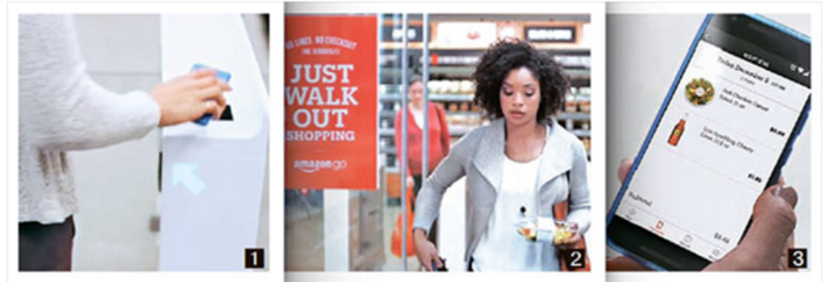
ITEM Description
01
02
Amazongo Humanless Mart
03
04
After signing on with a smartphone, they enter the Amazongo store.
You can carry the goods and leave the store without paying process in the store.
The details of automatic payment can be checked with a smartphone in Amazongo Application.

Slide 4
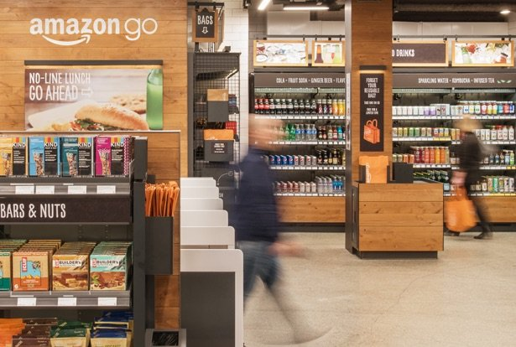
ITEM Description
01
02
Advantages
03
04
Convenience
Simplicity
Time saving
Running a humanless store in Korea using technology in Amazon.

Slide 5





ITEM Description
01
02
03
04
Find out profits come out and cost reduction by introducing Amazon high technology to medium sized mart.

Slide 6

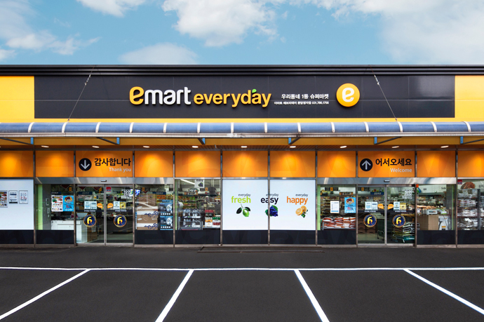
Perspective in Analysis
01
02
03
04
Manager in Emart-everyday

Slide 7
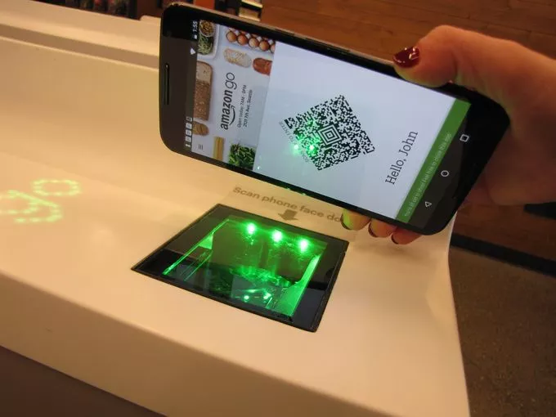
Technologies Adopted
01
02
1. QR code entrance
03
04
Notice people as customer with scanning QR code in Amazongo application

Slide 8
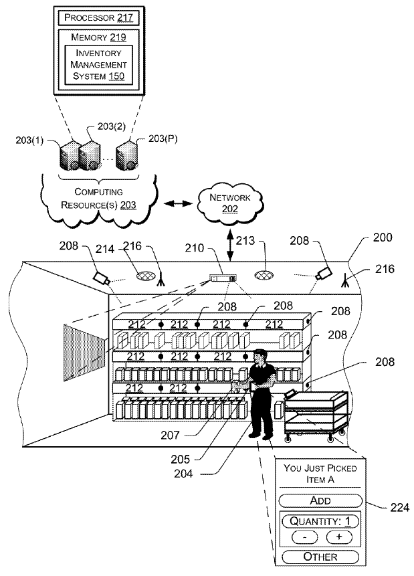
Technologies Adopted
01
02
2. Just Walk Out Technology[Computer Vision, Deep Learning, Sensor Fusion]
03
04
1. While the customer is shopping, a circular camera with an autonomous travel sensor follows the circulation of the shopping customer and checks the purchase list.
2. As soon as the customer lifts the product onto the shelf, it is registered in the virtual shopping cart. Through the camera and sensor, the customer is aware of lifting the product on the shelf.

Slide 9
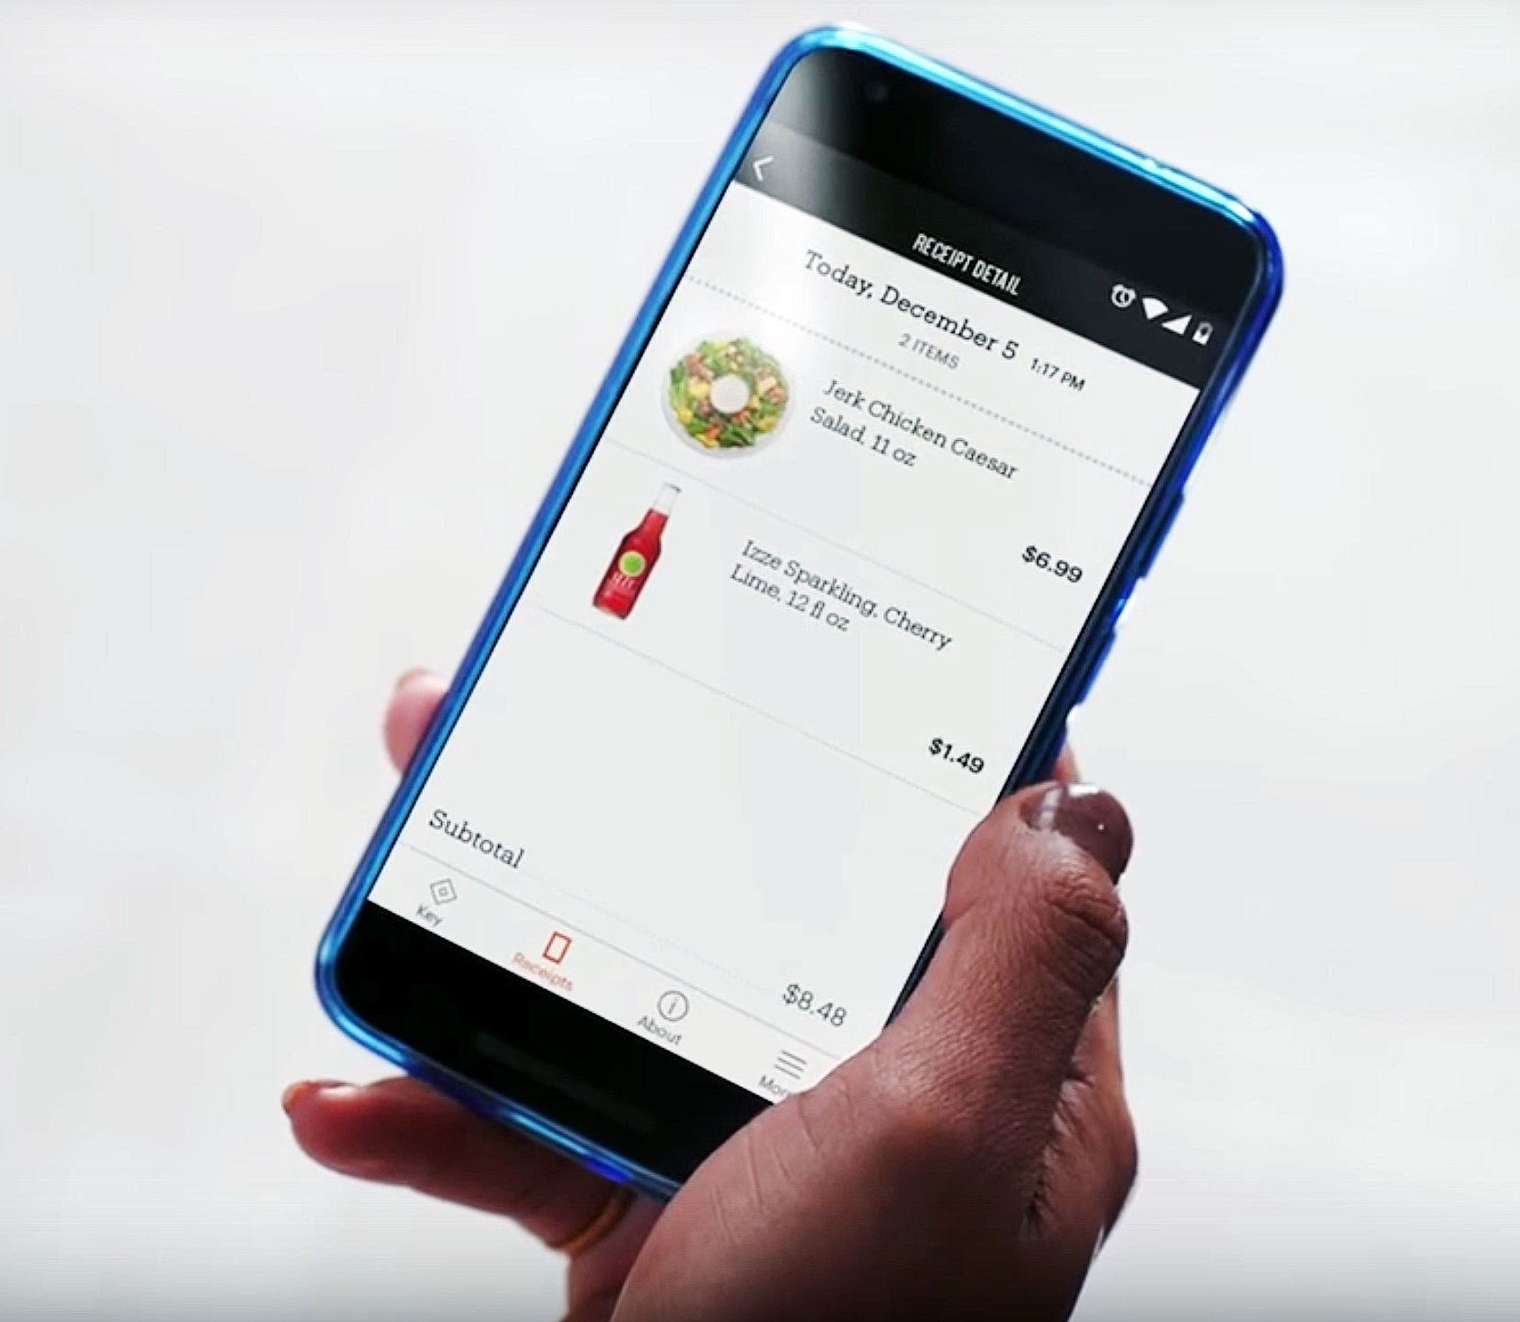
Technologies Adopted
01
02
3. Automatically Payment
03
04
When a customer leaves the store, the payment is automatically calculated by the payment method registered in the app and the receipt is sent to the customer's account.

Slide 10
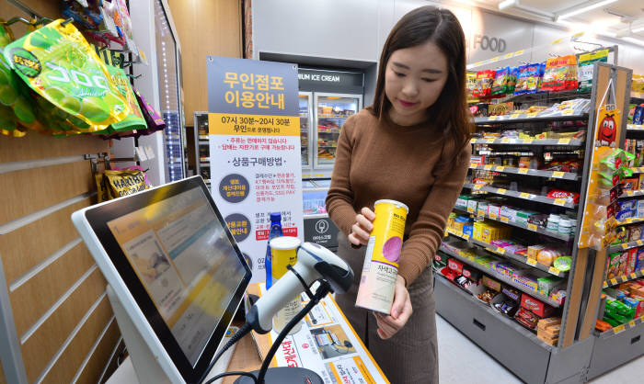
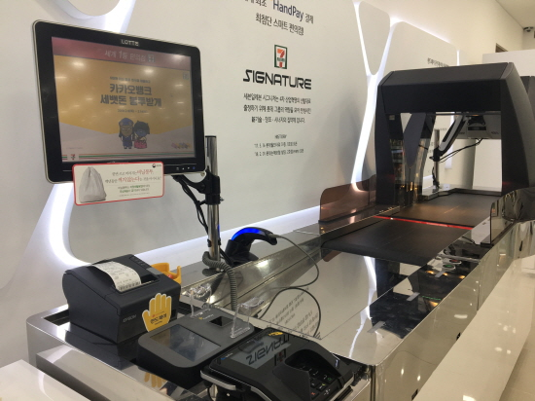
Current Status & Future Prospective
01
02
03
Current Status in Korea
04
Current humanless convenient mart in Korea
Need time to pay

Slide 11
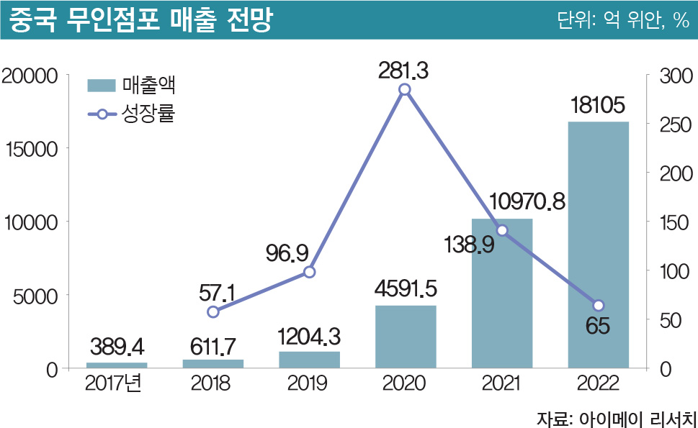
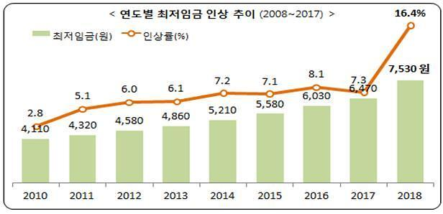
Current Status & Future Prospective
01
02
03
Future Prospective
04
The minimum wage will increase continually in the future. Humanless marts, where labor costs are reduced, will become even more competitive.
As graph above shows aspects of increasing sales in unmanned store.

Slide 12

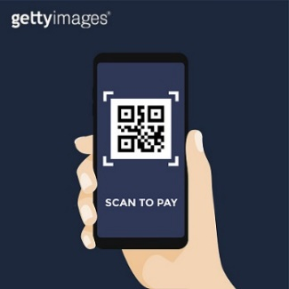
Customer Analysis
01
02
03
Teenagers
04
20-40 Age
40-60 Age
Over the 60
All age groups can be our customer.

Slide 13

Customer Analysis
01
02
Customer Feature
03
04
Using Smartphone Application for Shopping

Slide 14
Competitors Analyses
01
02
03
Existing Competitors
04
Medium sized chain markets
Target local commercial area(Local customers)
Subjected to government regulation
Also, called SSM(Semi-Large Sized Mart)

Slide 15

Competitors Analyses
01
02
03
04
Existing Competitors
2. Local Medium Sized Market
Target local commercial area(Local customers)
Not subjected to government regulation

Slide 16
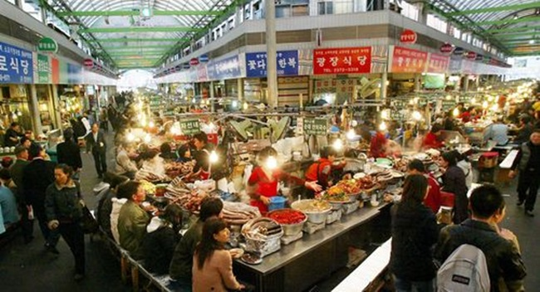
Competitors Analyses
01
02
03
Existing Competitors
04
3. Traditional Market
Target local commercial area(Local customers)
Subjected to government incentive policy

Slide 17

Competitors Analyses
01
02
Competitors(Convenience Store)
03
04
- The strong point of accessibility and convenience
- Low variety of products

Slide 18



Competitors Analyses
01
02
03
Emerging Competitors
04
Humanless mart project
(“Project Kelper”)
Introducing Self-Counter

Slide 19
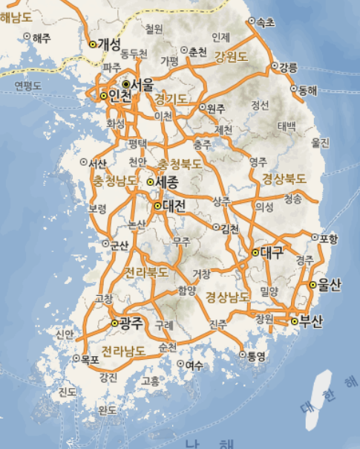
Market Analyses -Size
01
02
The number of
E-mart Everywhere
03
6
04
41
(
Market Size
)
16
97
The number of buyers
28
The number of sellers
9
The potential users of ‘E-mart Everyday’ living around the store could be our market size
33

Slide 20
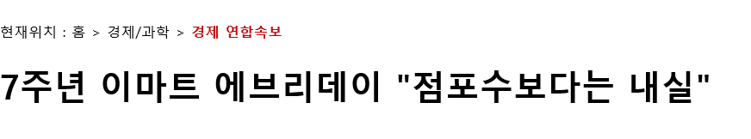
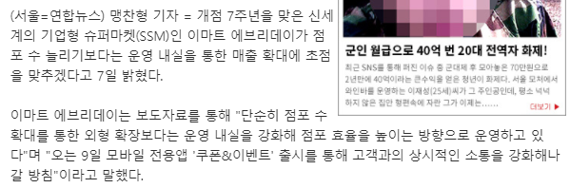
Market Analyses -Size
01
02
03
04
‘Emart-Everyday’ will focus on making each store more intensive rather than increasing the number of store.
So, the market size of ‘Emart-Everyday’ could not be larger.

Slide 21
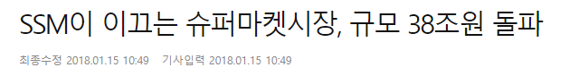
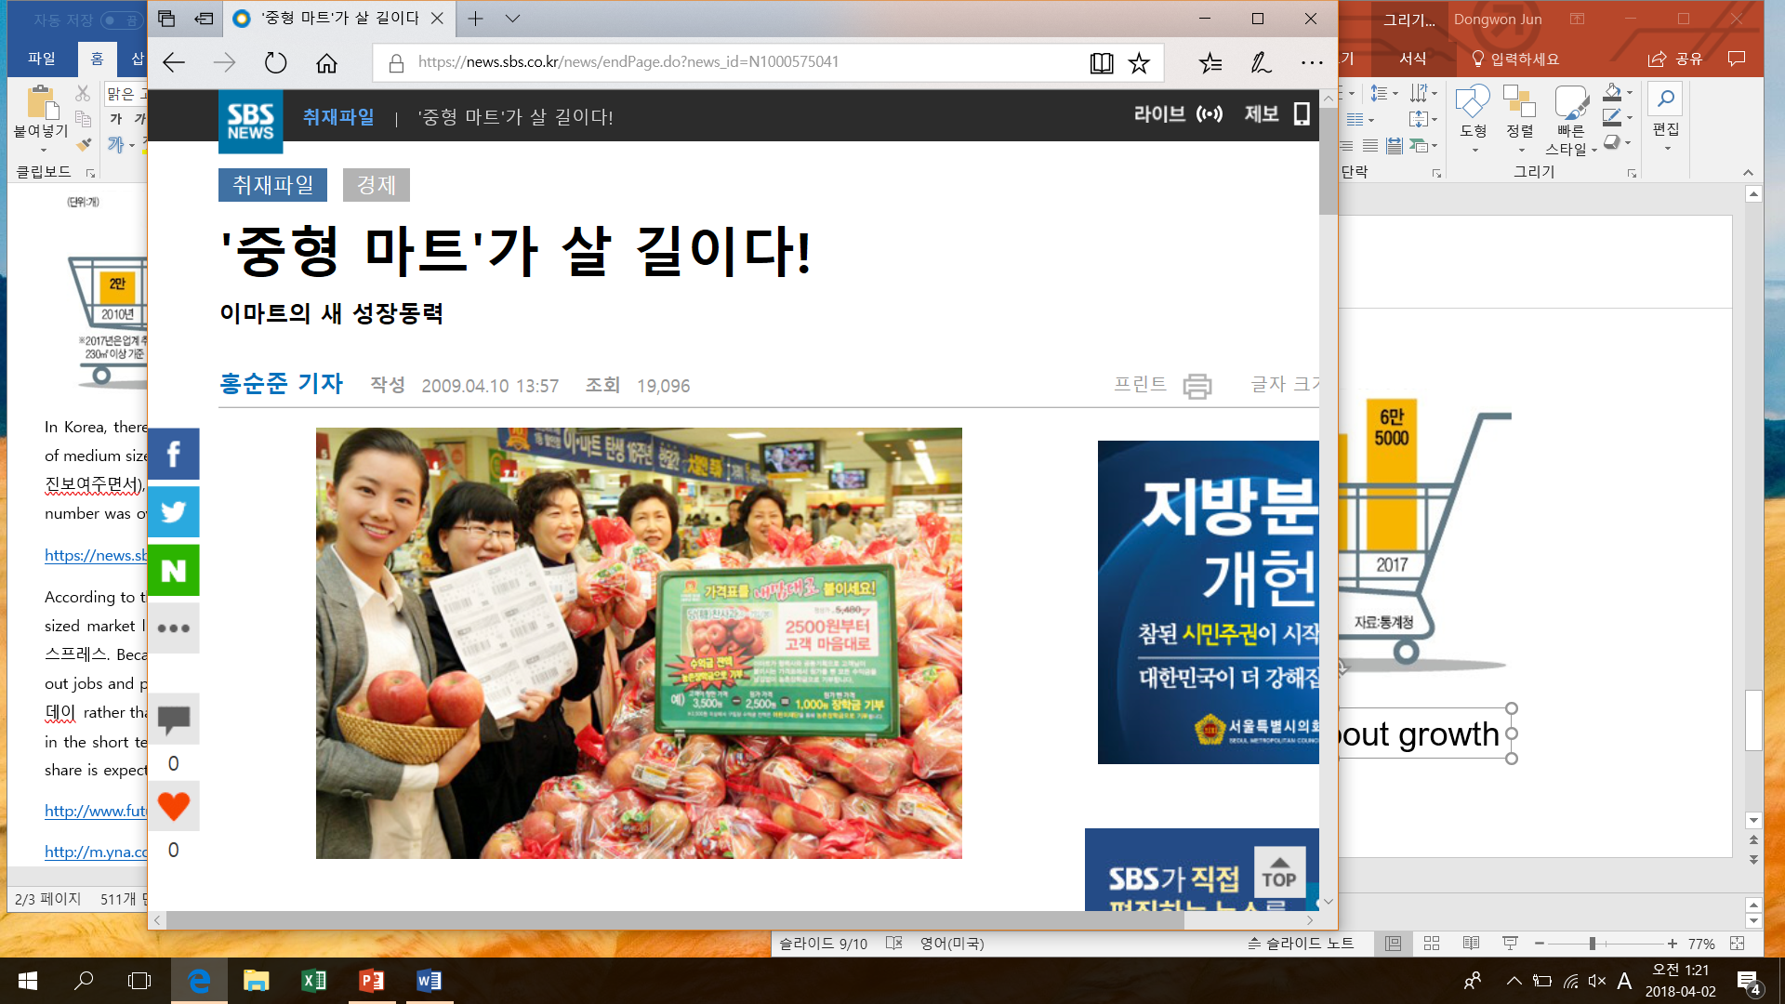

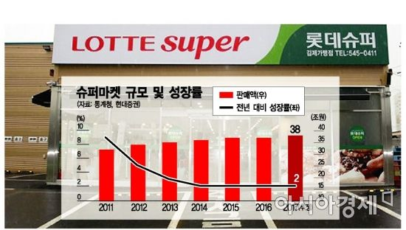
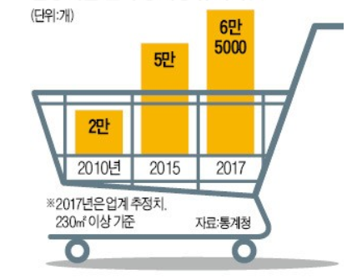
Market Analyses -Growth
01
02
03
04
Although the growth rate for mid-sized marts has been slowing down in the short term due to the fact that regulations are applied to medium-sized marts, the market share is expected to increase further in the long term.

Slide 22
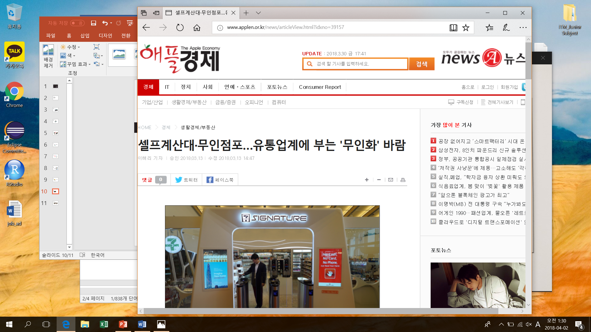
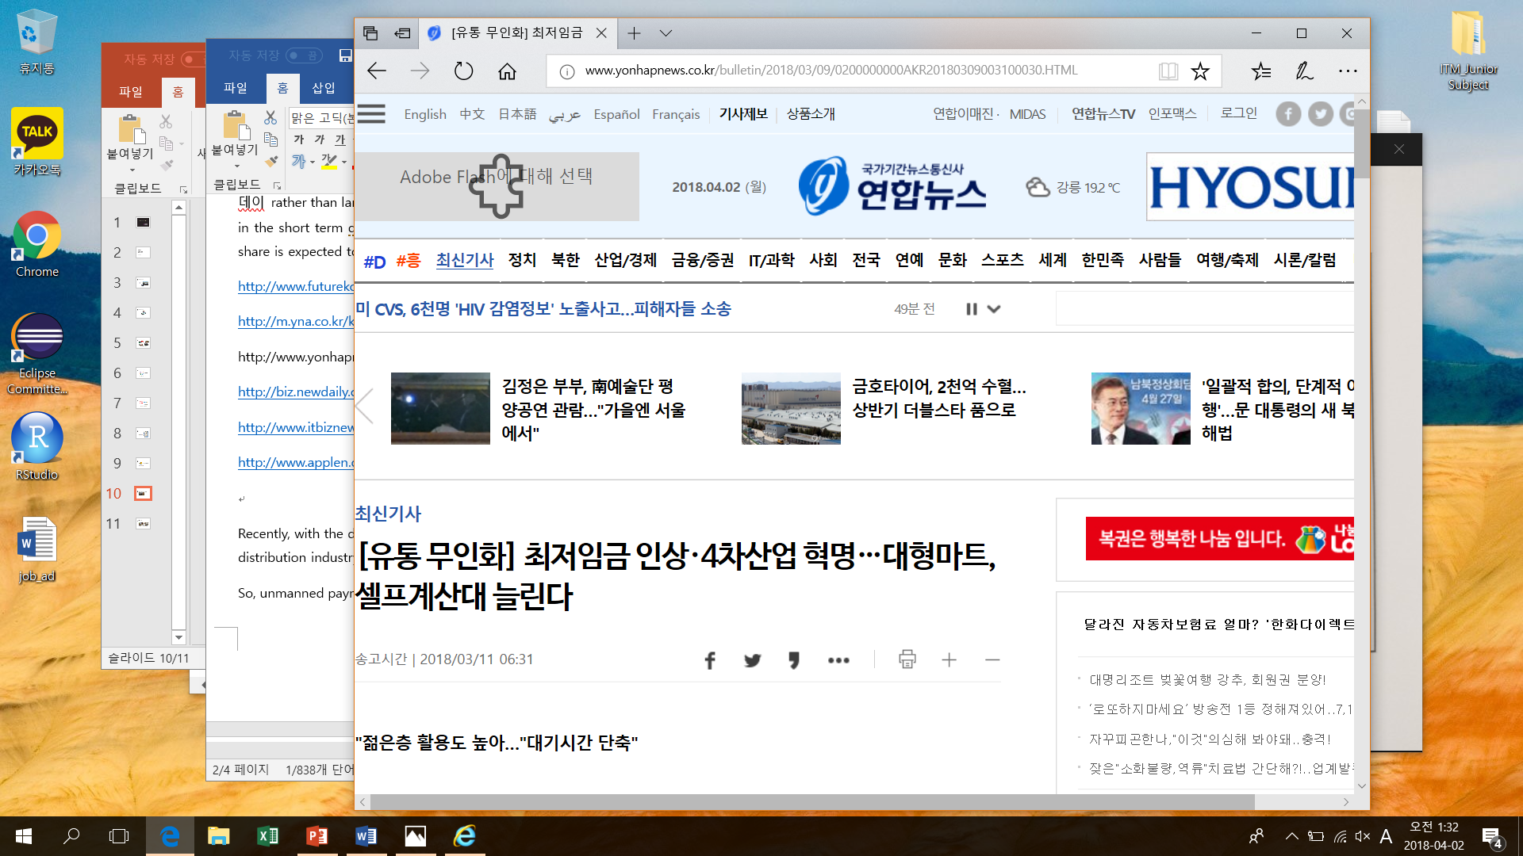
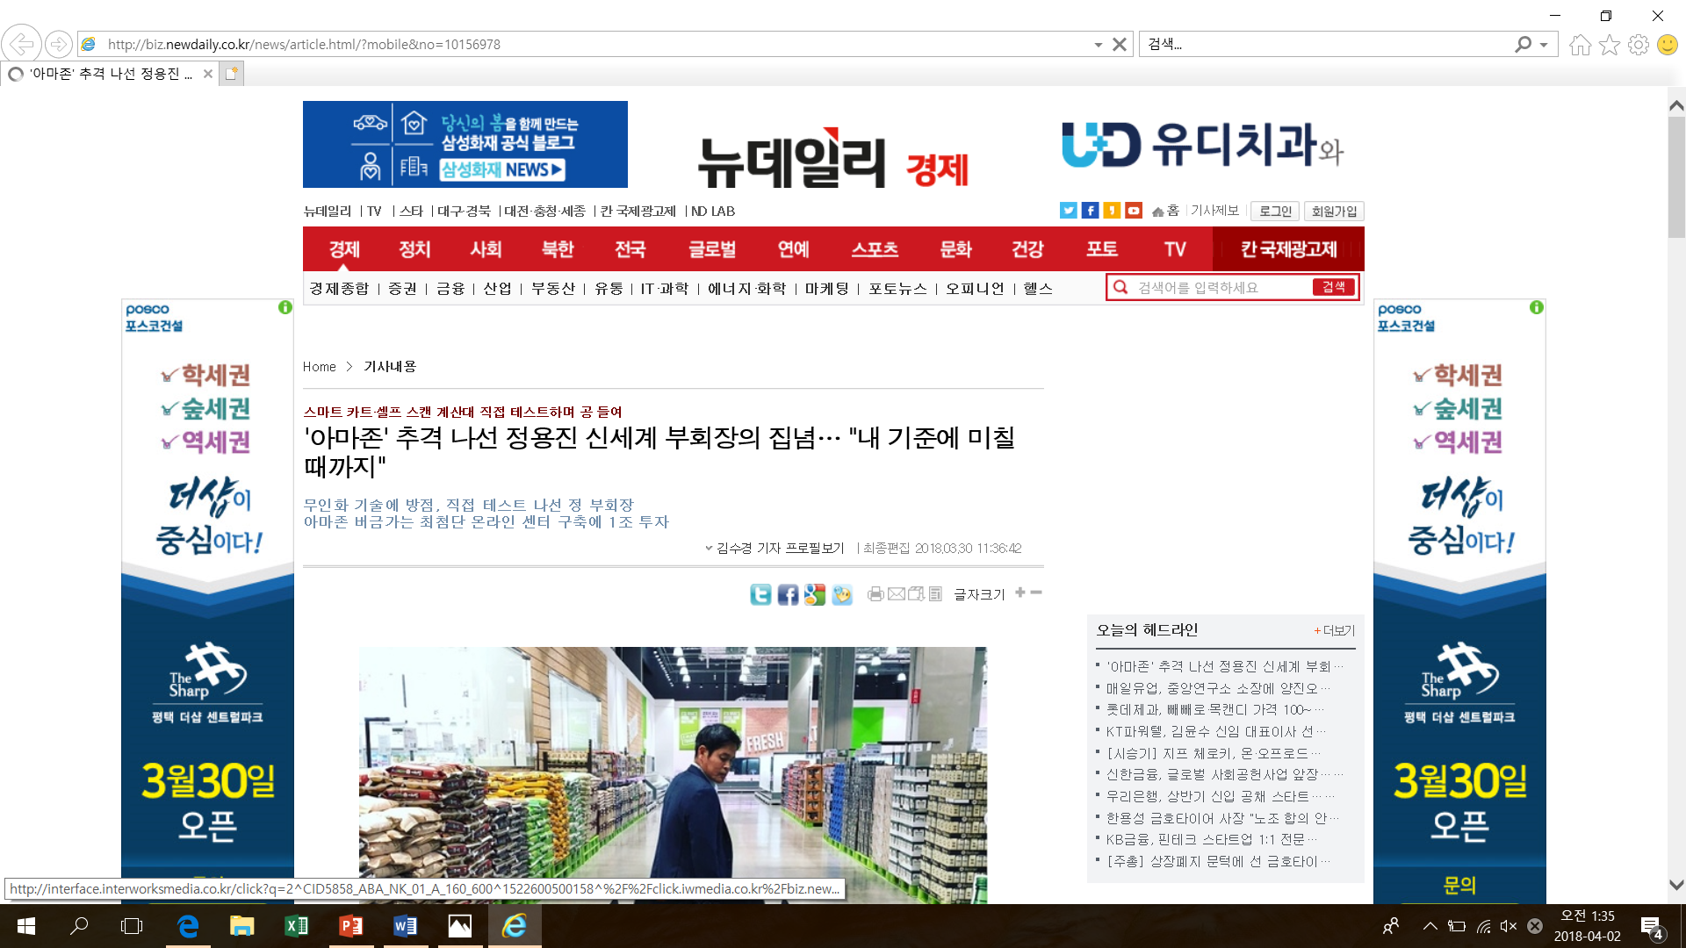
Market Analyses -Growth
01
02
03
04
Recently, with the development of IT technology, the government is pushing the ‘unmanned’ to the distribution industry due to the labor cost burden caused by the increase of the minimum wage.
In the examples described above, we can see that the unmanned technology market is growing.

Slide 23
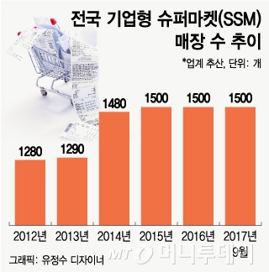
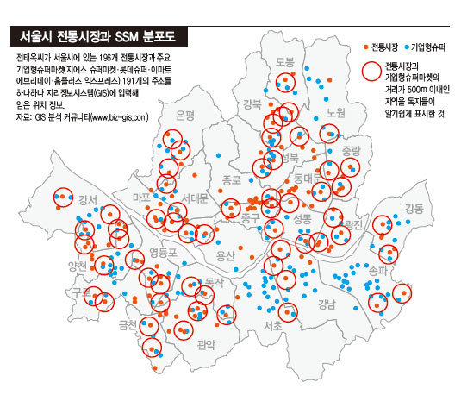
Market Analyses -Saturation
01
02
03
04
As you see the left picture above, the number of SSM increases continually and the right picture shows the high saturation of SSM in Seoul.

Slide 24
Market Analyses –Life Cycle
01
02
Introduction of New Technology
Dominating Market in Advance
New Competitor
Market Saturation
Developing New Technology
03
04
Expected Life Cycle

Slide 25
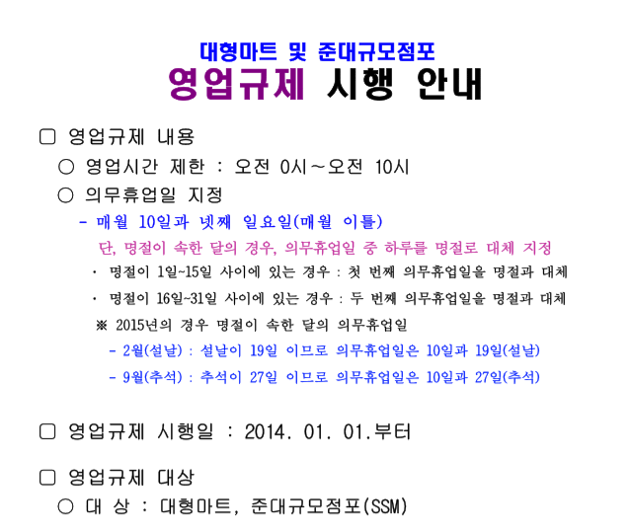

Regulations
01
02
The regulation of sales of large-scale mart and SSM.
03
04
- The contents of this regulation are restriction of business hours and two days off duty on weekends in a month.
- There is a controversy that these regulations are not practical and not fit to the objectives.

Slide 26
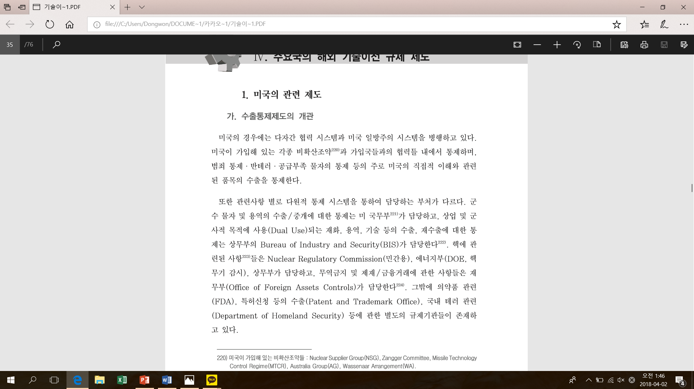
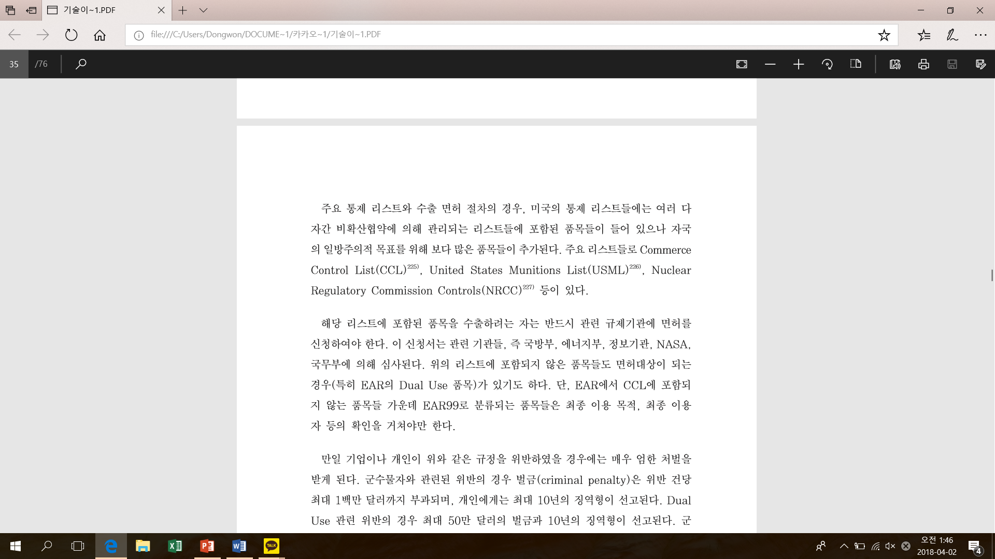
Regulations
01
02
2. The regulation of technology transfer
03
04
Regulations to prevent technology leakage should be well maintained in the process of technology transfer.

Slide 27
Benefit & Cost
[ Introduction Phase ]
01
02
Technology would be applied to over 230 stores nationwide for 3 years.
03
6
41
04
16
97
First year :
28
Seoul + Busan = 74 stores
9
Second year :
Kyungki = 97 stores
33
Third year :
Rest of stores = 59 stores

Slide 28
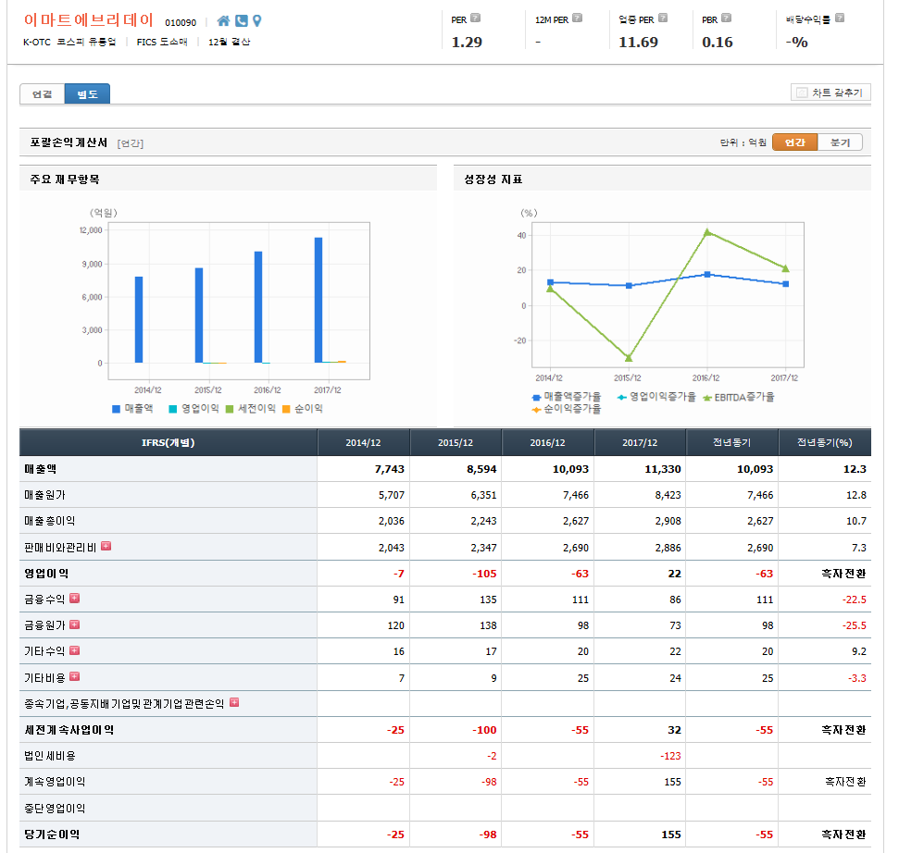
Benefit & Cost
[ Criteria ]
01
02
03
04
Criteria of change
For analyzing the change of B&C, use financial statements

Slide 29
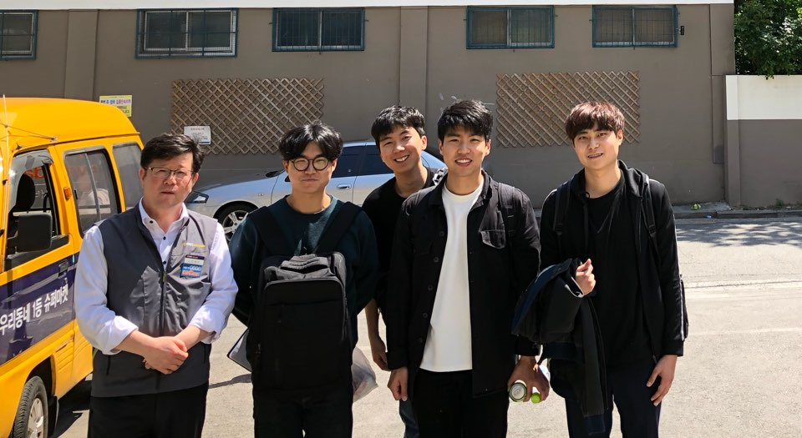
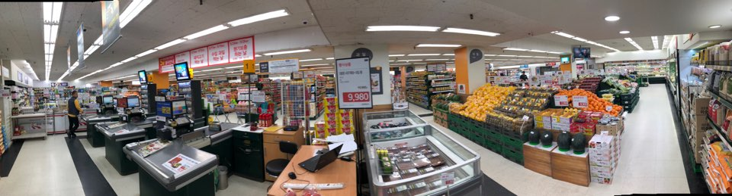
Benefit & Cost
[ Criteria ]
01
02
By Interview with manager in Emart everyday ChangDong
03
04
EMART everyday
In ChangDong
245 pyoung
OPEN AM10:00 – CLOSE PM11:00

Slide 30
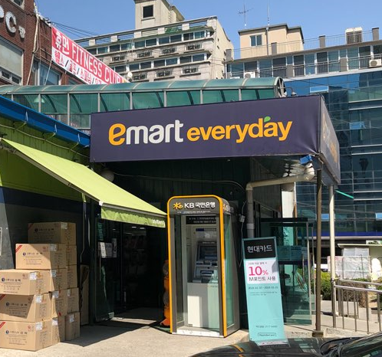
Benefit Analysis
[ Save Labor Cost ]
01
02
03
Full-time employee : 6 people
Initial wage: 2,000,000won
Average wage: 3,000,000won
Part-time employee: 14 people
Hourly wage: 8,000 won(7hours)
04
Humanless Technology
Decrease
Casher,
Stand Administrator

Slide 31

Benefit Analysis
[ Save Labor Cost ]
01
02
Casher: 5 people
8,000won * 13hours * 3counters * 30days
= 9,360,000won / month
Stand Administrator: 2 people in 4
8000won * 7hours * 2 people * 30days
= 3,360,000won / month
03
04
12,720,000 won * 12months
= 152,640,000 won / store in one year

Slide 32
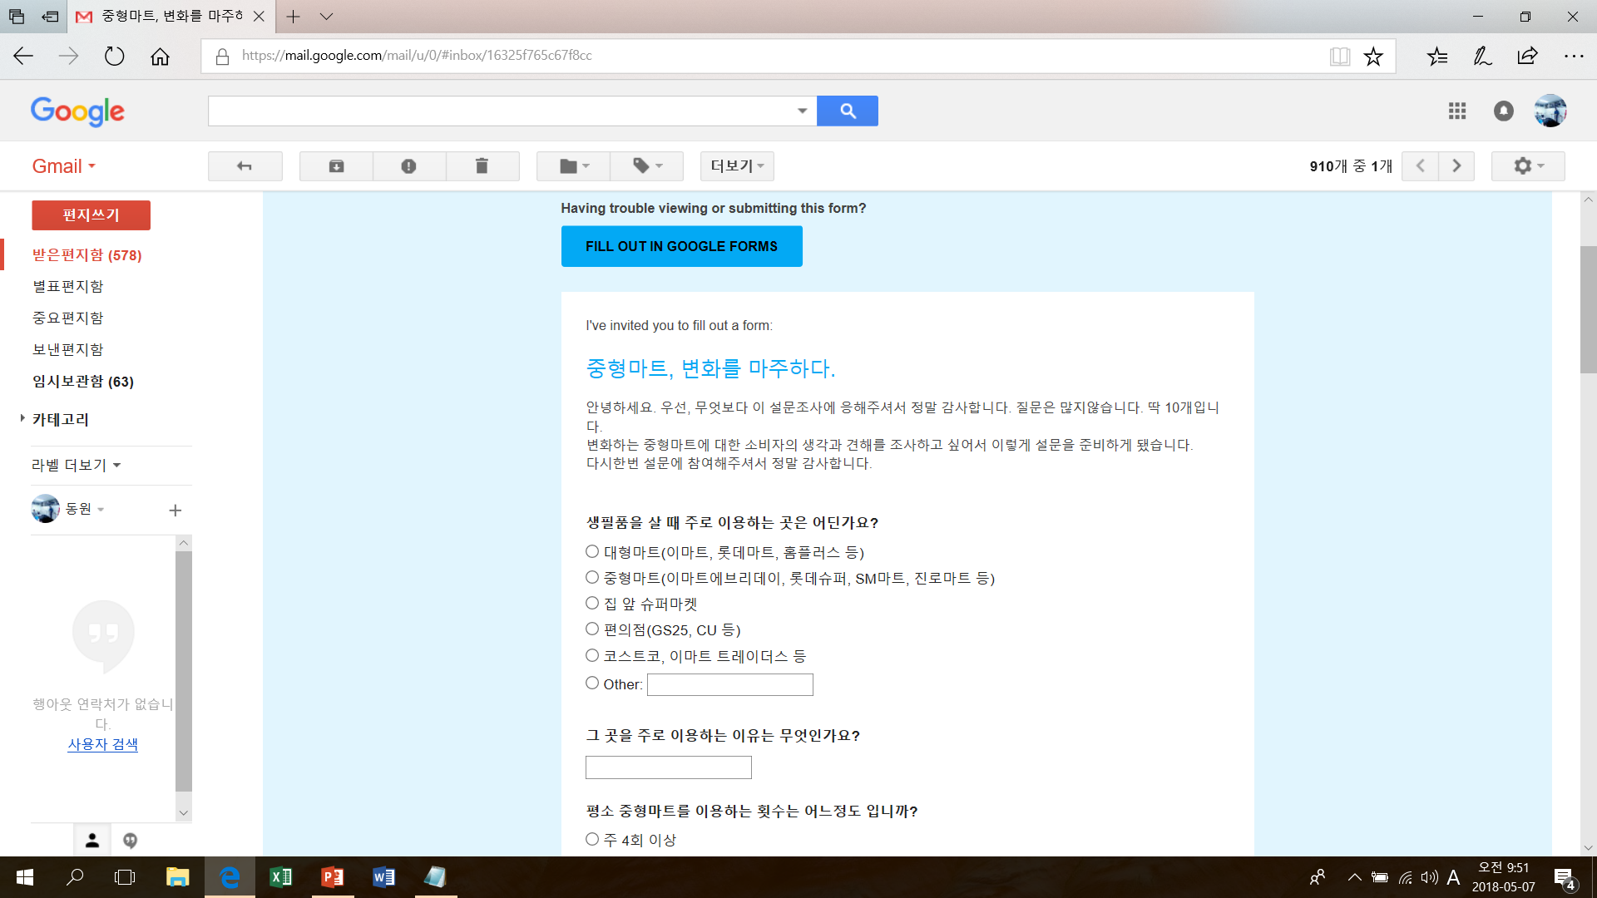
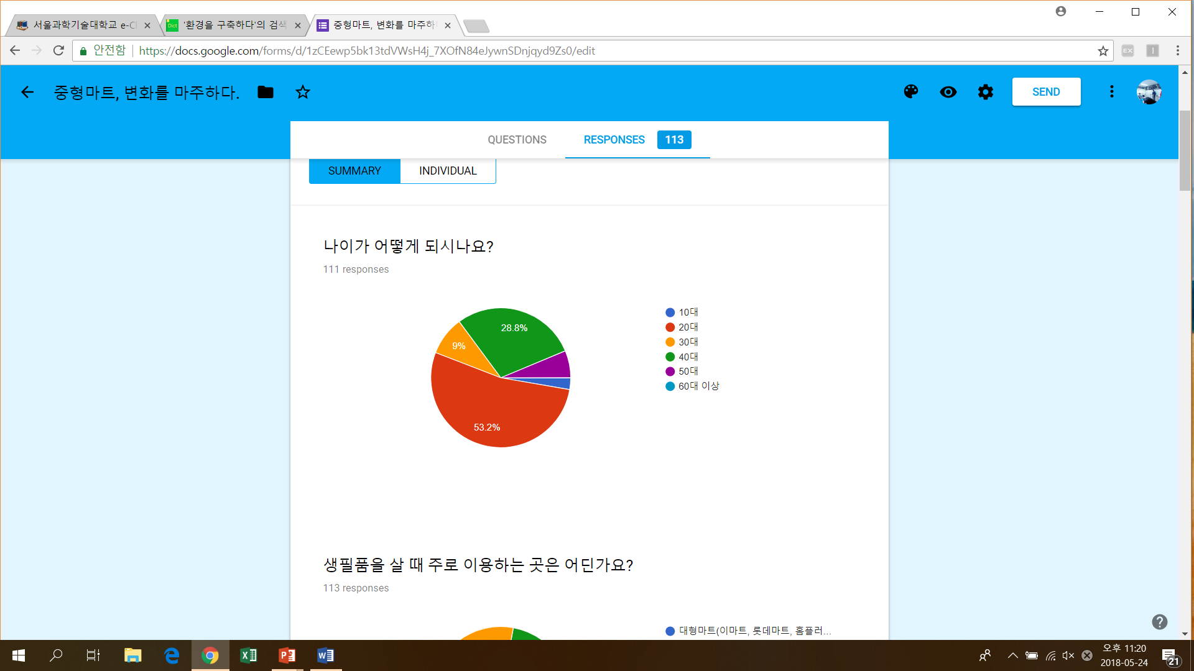
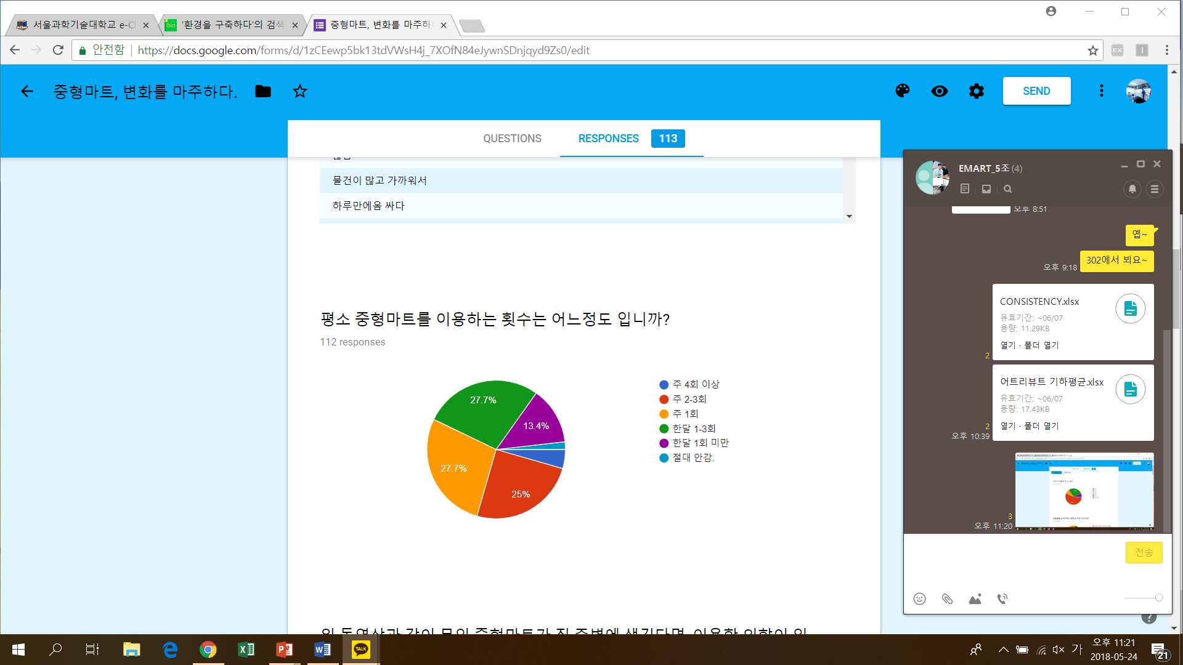
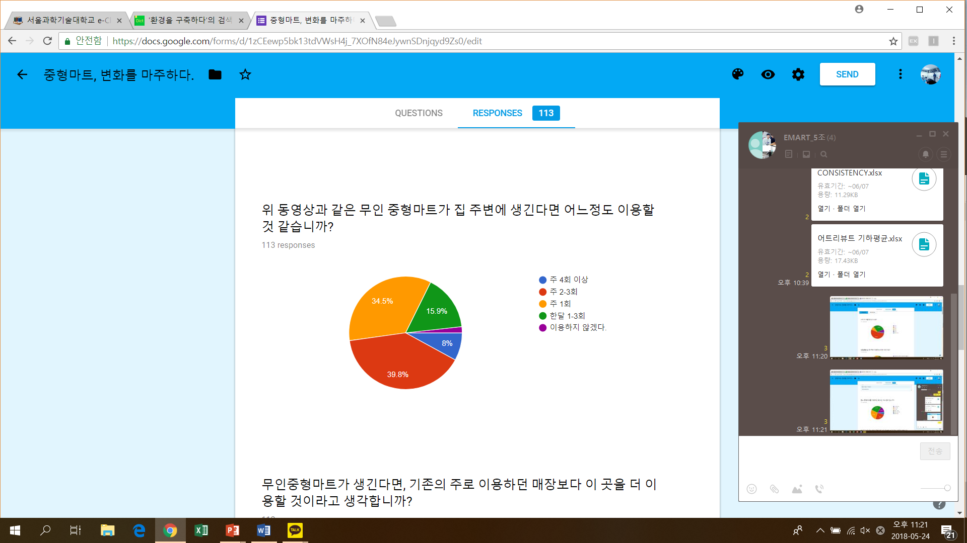
Benefit Analysis
[ Convenience Effect ]
01
02
03
To check rate of change to use mart through range of age
04
Analysis through survey
111 people response to the survey
Assume a change in ratio of use

Slide 33
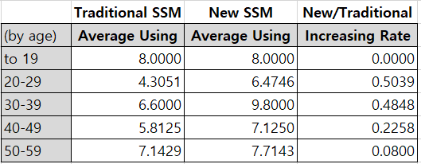
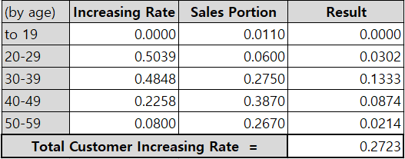
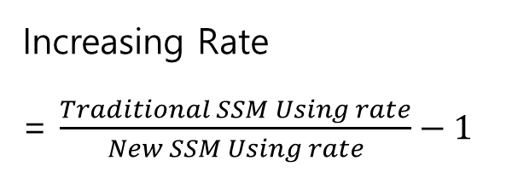
Benefit Analysis
[ Convenience Effect ]
01
02
03
Increasing Rate
= $\frac{Traditional SSM Using rate}{New SSM Using rate}−1$
04

Slide 34
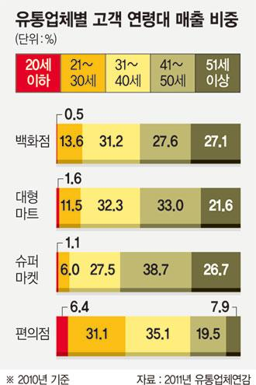
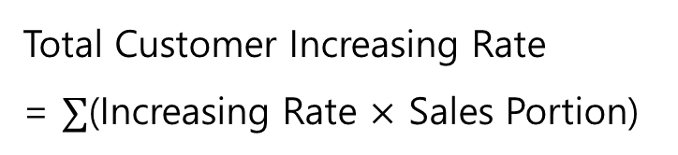
Benefit Analysis
[ Convenience Effect ]
01
02
03
04
Total Customer Increasing Rate
= $∑$(Increasing Rate $×$ Sales Portion)
27% of Customers would be increasing

Slide 35
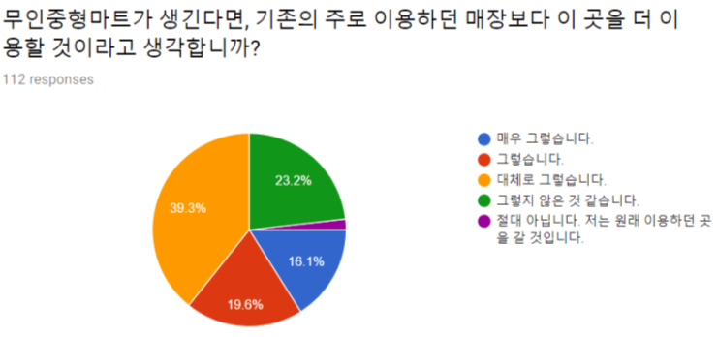
Benefit Analysis
[ Convenience Effect ]
01
02
03
04
27%(increased customers) x 35%(newly inflowed customers) = 9.45%(increased gross profit)
9.45% of Gross profit would be increasing

Slide 36
Benefit Analysis
[ Convenience Effect ]
01
02
Original Gross Profit * 109.45% * α = New Gross Profit
α = Reflection of Phase
Change of gross profit by change of customers
[ Benefit]
Total gross profit – original gross profit
Growth of gross profit reflects technology introduction phase

Slide 37
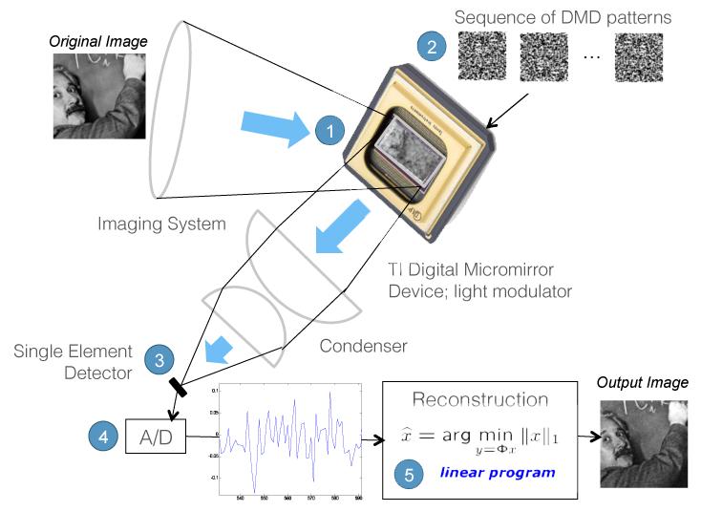
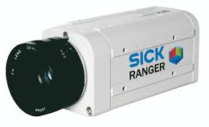
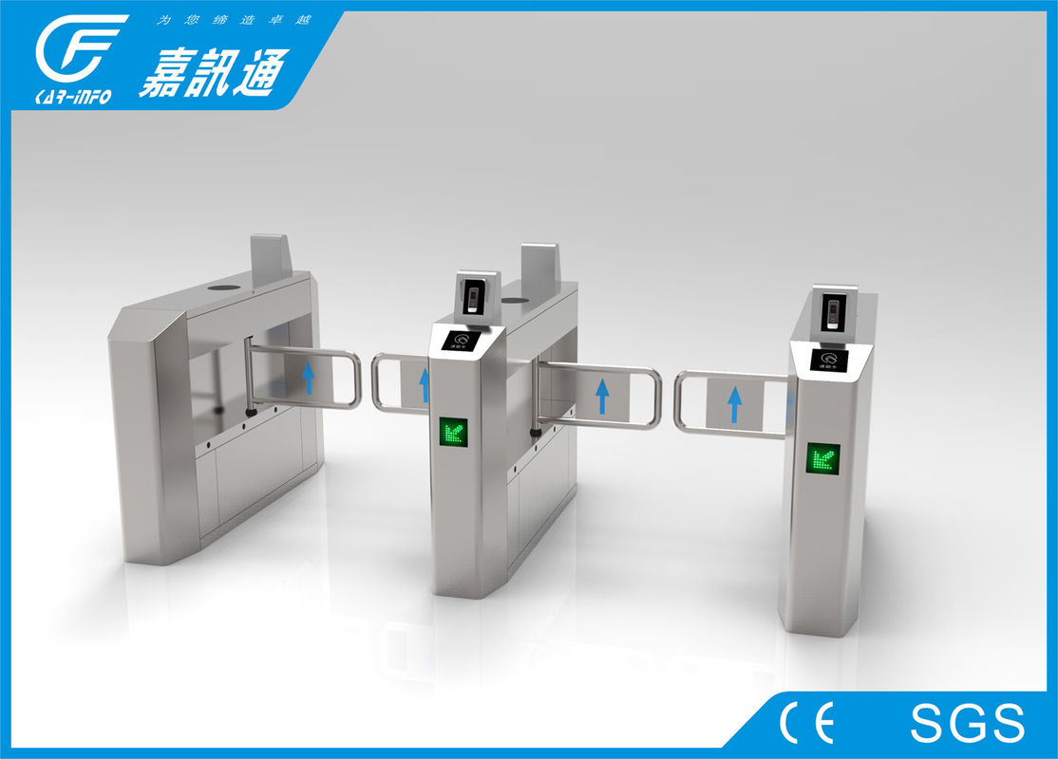
Cost Analysis
[ Installation Cost ]
01
02
RGB Camera
Sensing Camera
AmazonGo Technology
+ Other Machines
Entrance & Exit

Slide 38
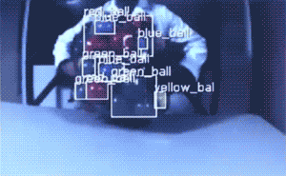
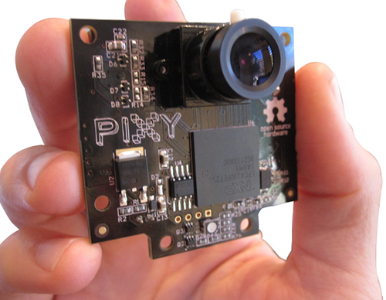
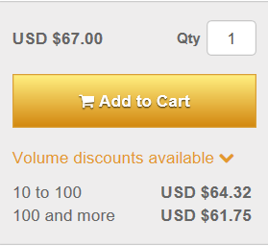
Cost Analysis
[ Installation Cost ]
01
02
Sensing Camera
: Can analyze the action of human
50,000 won

Slide 39
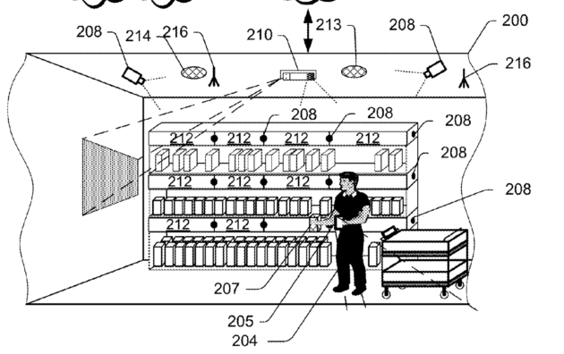
Cost Analysis
[ Installation Cost ]
01
02
Purchasing sensing camera is based on the Amazon Go Technology

Slide 40
Cost Analysis
[ Installation Cost ]
01
02
Sensing Camera
1 Part
C
1 Stand = 6 Parts
C
C
C
C
C
C
Part 1
Part 2
Part 3
Part 4
Part 5
Part 6
7 Cameras
= 350,000 won
7 * 6 = 42 Cameras
= 2,100,000 won

Slide 41
Cost Analysis
[ Installation Cost ]
01
Sensing Camera
Part
02
Stand
(350,000(part) * 30 + 2,100,000 (stand) * 48) = 111,300,000 won

Slide 42
Cost Analysis
[ Installation Cost ]
01
02
RGB Camera
In store already
: Can analyze the location of human
0 won

Slide 43
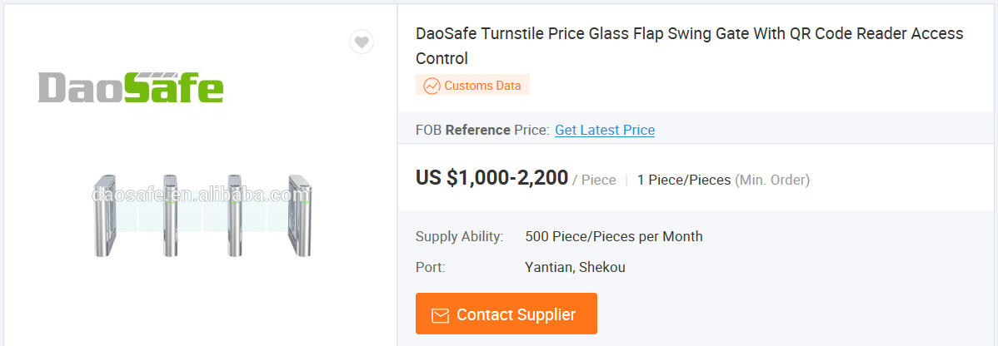
Cost Analysis
[ Installation Cost ]
01
02
Market Entrance
: Can identify customers by QRcode
1,500,000 won
( 1,500,000 * 3 (Entrance) + 1,500,000 * 2 (Exit )
= 7,500,000 won

Slide 44
Cost Analysis
[ Installation Cost ]
01
02
111,300,000 won
0 won
7,500,500 won
118,800,000 won
1.2 (Other Cost by assumption)
Total Installation Cost per store :
142,560,000 won

Slide 45
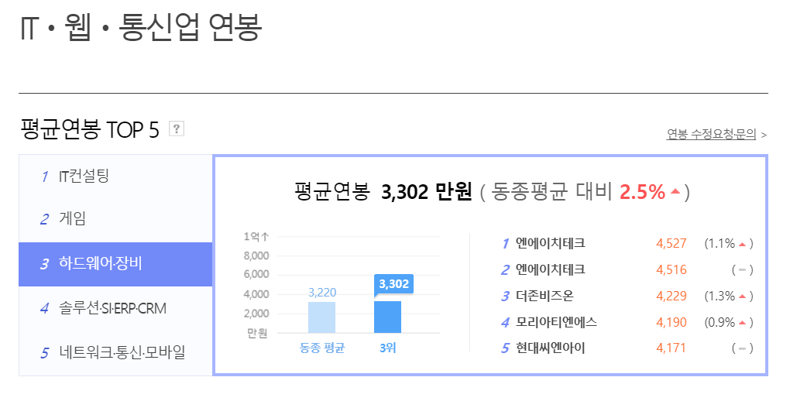
Cost Analysis
[ Maintenance Cost ]
01
02
Engineers for New technology of IT Department in Emart everyday
10 people needed
35,000,000 won / person
35,000,000 * 10 = 350,000,000 won
Wage for Engineer

Slide 46

Cost Analysis
[ Maintenance Cost ]
01
02
Mechanics for New technology of IT Department in Emart everyday
3 people needed in 1 team
24,000,000 won / person
24,000,000 * 3 = 72,000,000 won
Wage for Mechanic

Slide 47
Cost Analysis
[ Maintenance Cost ]
01
02
6
41
Seoul: 5 Teams
Incehon: 2 Teams
Kyungki: 10 Teams
Chungcheong: 3 Teams
Jeonra: 1 Teams
Gangwon: 1 Teams
GyeongSang: 4 Teams
Total team: 26 Teams
16
97
28
9
Total maintenance cost = 72,000,000 * 26
= 1,872,000,000 won
33
Wage for Mechanic

Slide 48
Cost Analysis
[ Maintenance Cost ]
01
02
350,000,000 won
1,872,000,000 won
2,222,000000 won
1.2 (Other Cost by assumption)
Total Maintenance Cost
for additional work force:
2,666,400,000 won

Slide 49


Cost Analysis
[ Maintenance Cost ]
01
02
α = Reflection of Phase
Existing maintenance Cost
X
(9.45% + α)
Total: 198billion
By Assuming
Increased Maintenance Cost
Increased maintenance cost reflects the technology introduction phase

Slide 50



Cost Analysis
[ Technology Cost ]
01
02
Computer Vision
Deep Learning
AmazonGo Technology
Sensor Fusion

Slide 51

Cost Analysis
[ Technology Cost ]
01
02
Real-time facial information detection & recognition
Permission Range | Non-exclusive commercial license
Contract Term | 5 years
Royalty | Initial Payment : 140,000,000 won Fixed Rate : 5%
Tuition fee | 2 month * 1,000,000 won
Detecting a facial information
Recognize whether registered person
[ Facial Detection ]

Slide 52
Cost Analysis
[ Technology Cost ]
01
02
Deep Learning based face detection technology
Permission Range | Non-exclusive commercial license
Contract Term | 5 years
Royalty | Initial Payment : 80,000,000 won Fixed Rate : 5%
Tuition fee | 2 month * 760,000 won
Creating a learning model from learning image database
Detecting not only face but also face of various angle
Complementing low detection rate of side face
[ Facial Detection ]

Slide 53
Cost Analysis
[ Technology Cost ]
01
02
Artificial marker based location recognition technology
Permission Range | Non-exclusive commercial license
Contract Term | 5 years
Royalty | Initial Payment : 40,000,000 won Fixed Rate : 5%
Tuition fee | 2 month * 856,800 won
Attaching an artificially created marker to the environment
Recognizing by camera image to locate the moving object
[ Location recognition ]

Slide 54
Cost Analysis
[ Technology Cost ]
01
02
Long/near sensor fusion-based user interaction technology
Permission Range | Non-exclusive commercial license
Contract Term | 5 years
Royalty | Initial Payment : 100,000,000 won Fixed Rate : 5%
Tuition fee | 1 month * 900,000 won
Use a both long range and short range sensors
Tracking of the whole body and hand joints of multiple users
Recognizing accurate and diverse movements
[ Action Recognition]

Slide 55
Cost Analysis
[ Technology Cost ]
01
02
Deep Learning based object recognition and detection technology
Permission Range | Non-exclusive commercial license
Contract Term | 5 years
Royalty | Initial Payment : 640,000,000 won
Tuition fee | 3 month * 1,000,000 won
Simultaneous recognition and classification of various objects
Recognizing and detecting objects with eye – level camera angles and high camera angles
[ Object Detection ]

Slide 56
Cost Analysis
[ Technology Cost ]
01
02
Initial Payment (Installation cost)
Fixed Rate (Operating cost)
Tuition Fee (Installation cost)
1,000,000,000 won
Gross Margin* 5 %
1 month : 4,516,800 won
2 month : 3,616,800 won
3 month : 1,000,000 won
Total fee : 9,133,600 won

Slide 57


Cost Analysis
[ Depreciation Cost ]
01
02
(Depreciation cost)
Book value as depreciation
Depreciation Cost

Slide 58


Cost Analysis
[ Tax Cost ]
01
02
New Taxable Income =
Growth of Gross profit + Reduction of Labor cost – Depreciation Cost – New Operating Cost
Calculate Tax with tax table
Labor costs are lowering
Sales are increasing
Depreciation costs are rising
Operating costs are increasing
Change of Tax

Slide 59

Cash Flow
01
02
Discount Rate = Emart Everyday rate of return (3.1%) + 3% = 6.1%
Cash Flow
B/C ratio = 1.84

Slide 60

AHP Decision Hierarchy
01
02
03
04
AHP Balanced Scorecard
Perspectives | GOAL | Measurement
Financial perspective | Being profitable in applying new technology | B/C Ratio
Customer perspective | Enhancing positive image of Company | Brand Image
 | Ensuring risk-safe Business in customer’s view | Technological problem
 |  | Social Problem
Internal business perspective | Constructing efficient business process. | Efficiency
Learning & growth perspective | Creating added value using stored data | Data utility

Slide 61
AHP Decision Hierarchy
01
02
03
Level1 | Level2 | Note
Finance | B/C Ratio | Benefit and Cost ratio of the applying new technology
Market Position | Brand Image | Enhancing brand image through the altered business
Utility | Efficiency | Changing ratio of the process efficiency
 | Data utility | Utilizing customer’s data and product data
Risk | Technological problem | Problem that can be occurred by technological issue
 | Social Problem | Problem that can cause social issue
04
Explanation

Slide 62
AHP Decision Hierarchy
01
02
Humanless Semi-sized mart
Finance
B/C Ratio
Market Position
Technical Problem
Social Problem
Risk
Utility
Brand Image
Efficiency
Data Utility
03
04
Level 1
Level 2
Introduction
Not Introduction
Level 3

Slide 63
AHP Decision Hierarchy
01
02
03
Decision Intensity
04
Definition | Intensity of Importance | Reciprocal
Extremely importance | 9 | 1/9
Very to extremely strongly importance | 8 | 1/8
Very strongly importance | 7 | 1/7
Strongly to very strongly importance | 6 | 1/6
Strongly importance | 5 | 1/6
Moderately to strongly importance | 4 | 1/4
Moderately importance | 3 | 1/3
Equally to moderately importance | 2 | 1/2
Equally importance | 1 | 1

Slide 64




AHP Decision Hierarchy
01
02
03
04
Geometric Mean:
Level 1 Hierarchy _ Factor Weight Matrix

Slide 65




AHP Decision Hierarchy
01
02
Geometric Mean:
03
04
With same way
Market Position
Level 2 Hierarchy _ Factor Weight Matrix

Slide 66






AHP Decision Hierarchy
01
02
03
Geometric Mean:
04
With same way
Level 3 _ Factor Matrix with survey by Team member

Slide 67
Computing Priority
01
02
03
04
Value / Sum
Average of (Value / Sum)
Sum of Column
[ Factor Weight Priority ]

Slide 68

Computing Priority
01
02
03
04
Value / Sum
Average of (Value / Sum)
Sum of Each Column
[ Factor Weight Priority ]

Slide 69

Computing Priority
01
02
03
04
Market Position
Multiply
[ Factor Weight Priority ]

Slide 70


Computing Priority
01
02
03
Each Value / Sum
04
Average of (Value / Sum)
Sum of Each Column
[ Factor Priority ]

Slide 71


Computing Priority
01
02
03
Each Value / Sum
04
Average of (Value / Sum)
Sum of Each Column
[ Factor Priority ]

Slide 72


Consistency Ratio
01
02
Level 1 Hierarchy
03
04
Sum
WSV / Priority
Value * Priority
CR = CI(0.0170) / RI(0.89) = 0.0191 <= 0.10
The values are relatively consistent
“n” number of comparisons | 1 | 2 | 3 | 4
Random index | 0.00 | 0.00 | 0.52 | 0.89
[ Factor Weight Consistency ]

Slide 73
Consistency Ratio
01
02
Level 2 Hierarchy
03
04
1 * 1 matrix : do not need to check consistency
Market Position
2 * 2 matrix : consistency vector is 2
Do Not Need Consistency Check
“n” number of comparisons | 1 | 2
Random index | 0.00 | 0.00
[ Factor Weight Consistency ]

Slide 74
Consistency Ratio
01
02
03
04
2 * 2 matrix : consistency vector is 2
Do Not Need Consistency Check
“n” number of comparisons | 1 | 2
Random index | 0.00 | 0.00
[ Factor Consistency ]

Slide 75


Selection Alternative
01
02
03
04
X
Factor weight priority x Factor Priority = Total Alternative Priority
Select Introduction Technology for humanless Mart

Slide 76
Conclusion
01
02
03
04
in Environment Analysis, B/C Ratio Analysis, AHP Analysis
Introduction the business is good choice as enterpriser in EMART Everyday

Slide 77
THANK YOU
[ Q & A ]

Slide 78

Reference
http://www.hani.co.kr/arti/society/society_general/463757.html
http://news.mt.co.kr/mtview.php?no=2017091911315613647
http://www.joongdo.co.kr/main/view.php?key=201606070570
http://www.asiae.co.kr/news/view.htm?idxno=2018011510492095284
http://www.joongdo.co.kr/main/view.php?key=201606070570
http://www.yangpatv.kr/news/articleView.html?idxno=8433
http://news.joins.com/article/21920414
http://digitalretail.co.kr/%EC%95%84%EB%A7%88%EC%A1%B4%EA%B3%A0amazon-go%EB%8A%94-%EC%96%B4%EB%96%A4-%EA%B8%B0%EC%88%A0%EC%9D%B4-%EC%A0%81%EC%9A%A9%EB%90%98%EC%97%88%EB%82%98/
http://m.yna.co.kr/kr/contents/?cid=MYH20180331005800038
http://www.yonhapnews.co.kr/bulletin/2018/03/09/0200000000AKR20180309003100030.HTML
http://biz.newdaily.co.kr/news/article.html/?mobile&no=10156978
http://www.itbiznews.com/news/articleView.html?idxno=9855
http://www.applen.or.kr/news/articleView.html?idxno=39157
Ansan-si Regional Economy Division
Korea Technology Trade Center
Emart-Everyday Web Site
https://news.kotra.or.kr/user/globalBbs/kotranews/4/globalBbsDataView.do?setIdx=243&dataIdx=165723
https://itec.etri.re.kr/itec/sub02/sub02_01_1.do
https://www.robotshop.com/en/pixy-cmucam5-image-sensor.html
https://www.alibaba.com/product-detail/DaoSafe-Turnstile-Price-Glass-Flap-Swing_60703836222.html?spm=a2700.7724838.2017115.1.45bf3809Vgz0CQ&s=p
http://www.saramin.co.kr/
https://comp.fnguide.com/SVO2/asp/SVD_Finance.asp?pGB=1&gicode=A010090&cID=&MenuYn=Y&ReportGB=&NewMenuID=103&stkGb=701
https://docs.oracle.com/middleware/12211help/biee/ko/bi.12211/e73384/GUID-8D489588-5717-42F8-BBDE-8CB110EEB0E8.htm#BIEUG1251
http://news.zum.com/articles/451388

